Slide 1
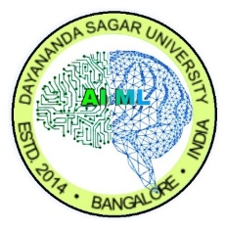


DAYANANDA SAGAR UNIVERSITY
SCHOOL OF ENGINEERING
DEPARTMENT OF ARTIFICIAL INTELLIGENCE & MACHINE LEARNING
Project Title
AI-Powered Meme Generator using LSTM & Streamlit
SUBMITTED BY
Amar H M (ENG23AM1001)
Sanjay S (ENG23AM1004)
Deepak Mehto (ENG22AM0087)
Shashanka N (ENG23AM1006)
Academic Year: 2024-2025

Slide 2
Introduction
Memes have become a popular and influential way of expressing ideas and emotions online.
They spread quickly, connect people through humor, and shape digital conversations.
With the growing use of social media, the need for fast and creative meme content has increased.
Memes are widely used for entertainment and communication.
They convey messages in a simple, visual, and relatable manner.
Users often struggle to think of clever or impactful captions.
Manual meme creation can be time-consuming.
Creative ideas are not always available when needed.
A tool that supports caption generation can save time and effort.
AI can help users express thoughts more easily and creatively.
The project aims to make meme creation accessible for everyone.

Slide 3
Problem Statement
The meme creation process often faces challenges due to the lack of quick and creative caption ideas.
Users struggle to generate witty or meaningful captions on the spot.
Manual caption writing is time-consuming.
Not everyone finds it easy to express humour or emotions through text.
Fast-paced social media trends demand quick content creation.
Limited instant ideas reduce creativity while making memes.
There is no simple tool to assist in generating captions quickly.
A solution is needed to streamline meme caption creation.

Slide 4
Objectives
The project focuses on delivering a reliable and intuitive gesture-based interaction system through the following goals:
Enable hands-free operation using defined hand gestures.
Reduce dependency on physical touch inputs.
Provide a faster and more natural interaction method.
Improve accessibility for users with mobility limitations.
Ensure high gesture-recognition accuracy.
Minimize system latency for smooth user experience.
Design the system to be lightweight and hardware-friendly.
Create a scalable base that can be extended to more gestures in the future.

Slide 5
Project Scope
This project defines the boundaries and extent of the gesture-based interaction system through the following points:
Focuses on recognizing a set of predefined hand gestures.
Covers real-time detection and response to user gestures.
Includes basic interface actions like navigation and selection.
Limits processing to commonly available hardware (webcam/laptop camera).
Ensures functionality in normal indoor lighting conditions.
Provides a simple, user-friendly interaction flow.
Excludes complex full-body motion tracking.
Excludes advanced AI decision-making beyond gesture mapping.

Slide 6
Tools & Technologies
The project is built using reliable and well-established tools:
Python for core program logic
OpenCV for real-time video processing
MediaPipe for hand-tracking and landmark detection
NumPy for numerical operations
Tkinter / Simple UI layer for interaction
Webcam or laptop camera for gesture input
VS Code for development
Windows environment for execution

Slide 7
Methodology / Approach
1. Data Collection
Gather a diverse set of meme templates and real-world images.
Include curated caption datasets containing humorous and contextual text.
2. Data Pre-processing
Resize and normalize images for the model.
Clean and filter captions to remove unwanted or offensive text.
Convert text into machine-readable tokens.
3. Feature Extraction
Use a CNN (e.g., VGG16 / ResNet) to extract visual features from the image.
Identify objects, background, and visual elements relevant for captioning.
4. Caption Generation Model
Use an encoder–decoder architecture combining:
  CNN → Image understanding

Slide 8
  LSTM / Transformer → Text generation
Add an attention mechanism to focus on key parts of the image.
5. Caption Refinement
Filter out harmful terms using a rule-based and AI-based content safety layer.
Apply grammar correction and humor enhancement.
6. Meme Template Integration
Place the generated caption onto the image using meme-style formatting.
Adjust text position, font size, and alignment.
7. Output Generation
Produce the final meme in downloadable format.
Option for multiple caption variations to choose from.
8. User Interaction Layer
Provide a simple UI where users upload an image and receive instant meme outputs.
Enable manual editing for caption customization.

Slide 9
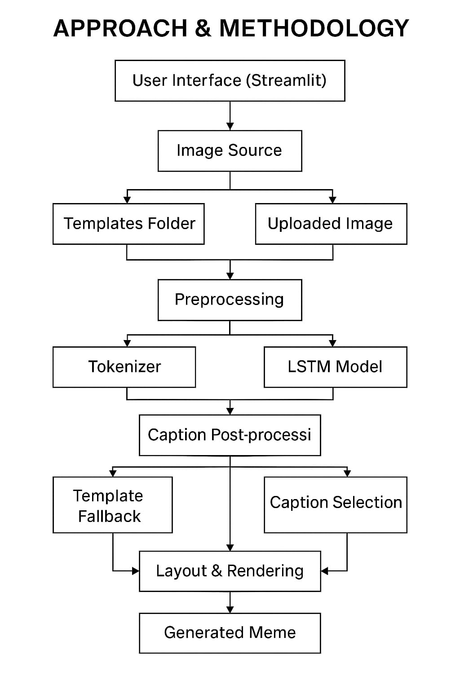
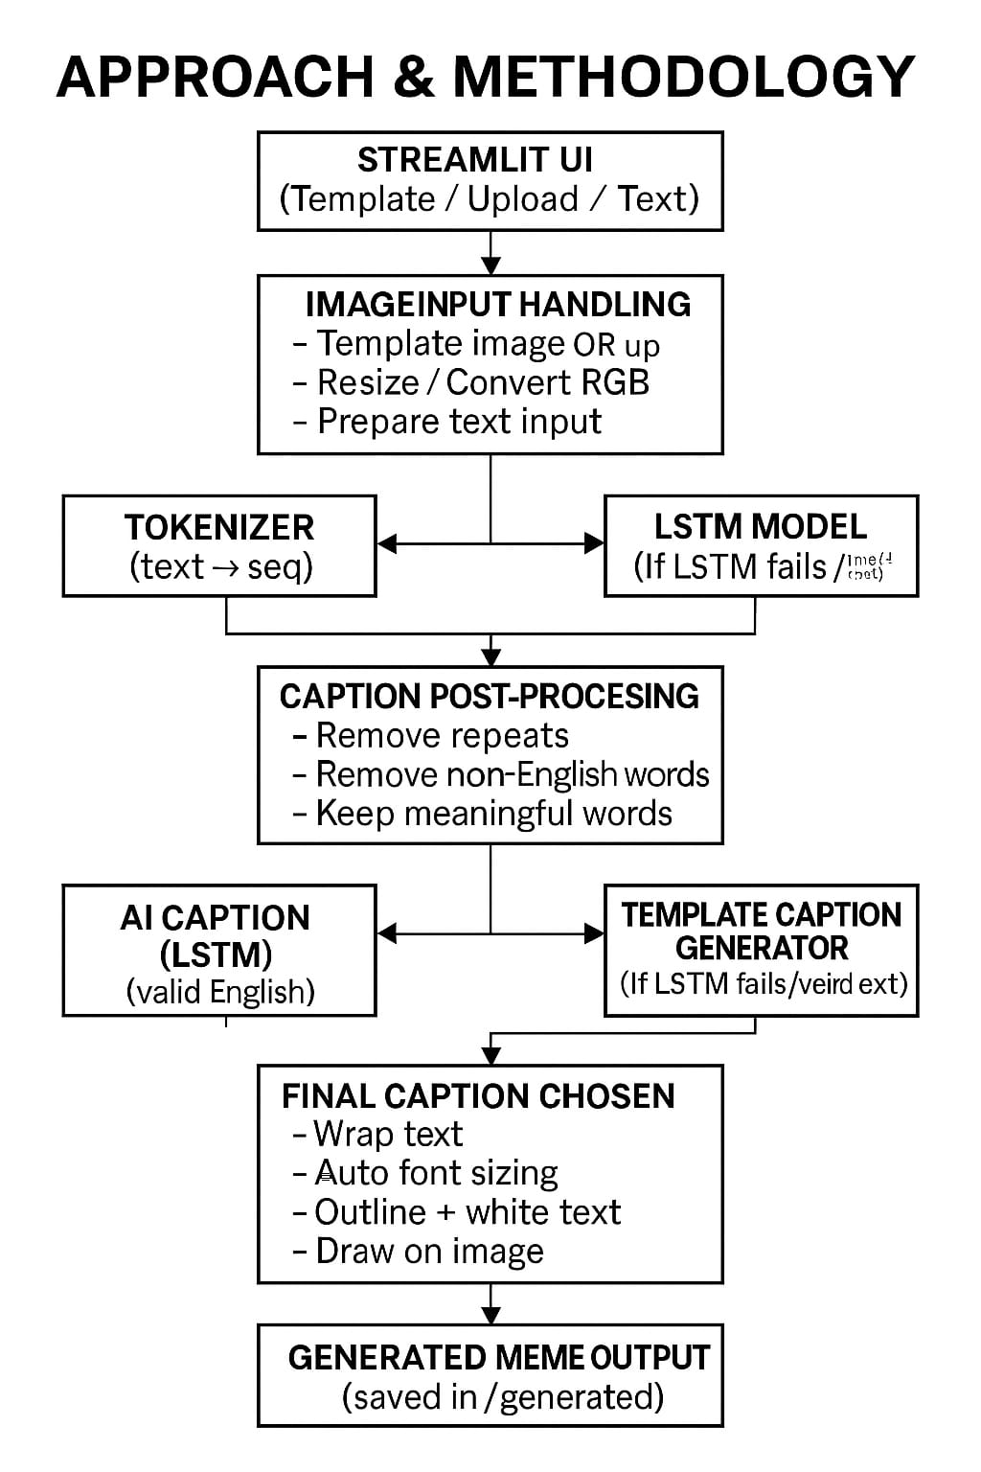

Slide 10
Expected Outcomes
A working system that generates meme captions automatically using an LSTM model.
Clear, meaningful, and English-friendly captions without random or inappropriate text.
High-quality memes created from both template images and user-uploaded pictures.
Fast caption generation with consistent formatting and clean text placement on images.
A fallback caption system that guarantees a usable result even when AI prediction fails.
An easy-to-use interface built with Streamlit for quick meme creation.
Improved user engagement through creative, context-aware meme outputs.
A reliable prototype demonstrating the practical use of Gen-AI in content creation.

Slide 11
Results & Analysis
The system successfully generated clear and meaningful meme captions for a wide range of topics.
LSTM predictions worked well for short, common topics and produced smooth, natural text extensions.
The quality-check filter removed weak or unsuitable outputs, ensuring only clean and usable captions were shown.
The template-based fallback system improved overall reliability, giving a valid caption even when the AI struggled.
The image rendering module placed captions neatly on the meme without overflowing or breaking layout.
User testing showed that the interface was easy to operate and produced results within seconds.
The model performed consistently across different images, demonstrating stability in real-time usage.
Overall, the project proved that Gen-AI can assist in simple creative tasks with good accuracy and dependable output.

Slide 12
Limitations
LSTM model may produce repetitive or less creative captions for uncommon topics.
Caption quality depends heavily on the training dataset size and diversity.
No deep understanding of humor or context beyond learned patterns.
System cannot guarantee perfect grammar in every generated caption.
Limited template library compared to real-time meme platforms.
No multilingual caption support in the current version.
Requires user input for topic — cannot fully auto-generate memes yet.

Slide 13
Future Scope
Integrating more advanced transformer models (like GPT-based captioning) for richer and more humorous outputs.
Adding multilingual caption generation to support regional languages.
Expanding the meme template library with trending and customizable formats.
Allowing users to edit or fine-tune AI-generated captions directly within the interface.
Enabling automatic image selection based on the topic for fully automated meme creation.
Implementing a user feedback loop so the model improves continuously.
Developing a mobile app version for faster, on-the-go meme generation.
Incorporating social media integration for instant sharing of created memes.

Slide 14
Conclusion
This project demonstrates how modern AI can be applied to a creative domain like meme generation, making the entire process faster, simpler, and more engaging for users. By integrating an LSTM-based caption generator with a streamlined interface, the system is able to produce meaningful, humorous, and context-aware captions with minimal user effort. It shows how AI can support everyday digital expression, not just through automation, but by enhancing creativity itself.
The project successfully highlights the potential of combining machine learning with real-world applications, proving that even simple models like LSTMs can deliver impressive results when paired with thoughtful post-processing and a clean user experience. Although the system has certain limitations, such as restricted understanding of humor and dependency on dataset quality, it establishes a strong and scalable foundation for future enhancements.
Overall, this work demonstrates the growing role of AI in content creation and offers a promising starting point for more advanced, intelligent, and interactive meme-generation systems in the future.

Slide 15
References
[1] V. Peirson and J. Tolins, “Dank Learning: Generating Memes Using Deep Neural Networks,” arXiv preprint arXiv:1806.04510, 2018.
[2] O. Vinyals, A. Toshev, S. Bengio, and D. Erhan, “Show and Tell: A Neural Image Caption Generator,” in Proc. IEEE Conf. Computer Vision and Pattern Recognition (CVPR), 2015, pp. 3156–3164.
[3] K. Xu et al., “Show, Attend and Tell: Neural Image Caption Generation with Visual Attention,” in Proc. Int. Conf. Machine Learning (ICML), 2015, pp. 2048–2057.
[4] J. Hessel, N. Lee, and L. Choi, “Something’s Off: Analyzing and Automating Visual Meme Understanding,” in Proc. IEEE Winter Conf. Applications of Computer Vision (WACV), 2020, pp. 2454–2463.
[5] J. Devlin, M. Gupta, and J. Pont-Tuset, “MemeCamp: A Dataset for Understanding and Generating Internet Memes,” in Proc. IEEE Conf. Computer Vision and Pattern Recognition Workshops (CVPRW), 2021, pp. 3585–3594.
[6] M. Hossain, F. Sohel, M. Shiratuddin, and H. Laga, “A Comprehensive Survey of Image Captioning Techniques,” ACM Computing Surveys, vol. 51, no. 6, pp. 1–36, 2019.
[7] S. Liu, H. Ren, and Q. Zhang, “Deep Learning in Image Captioning: A Survey,” ACM Trans. Multimedia Computing, Communications, and Applications (TOMM), vol. 18, no. 2s, pp. 1–27, 2022.

